Slide 1
Challenge 2 VBA Script
Kyle Eaton
6 March 2023

Slide 2
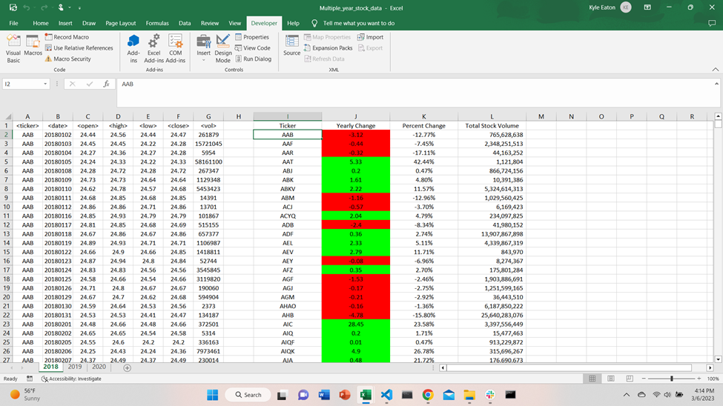

Slide 3
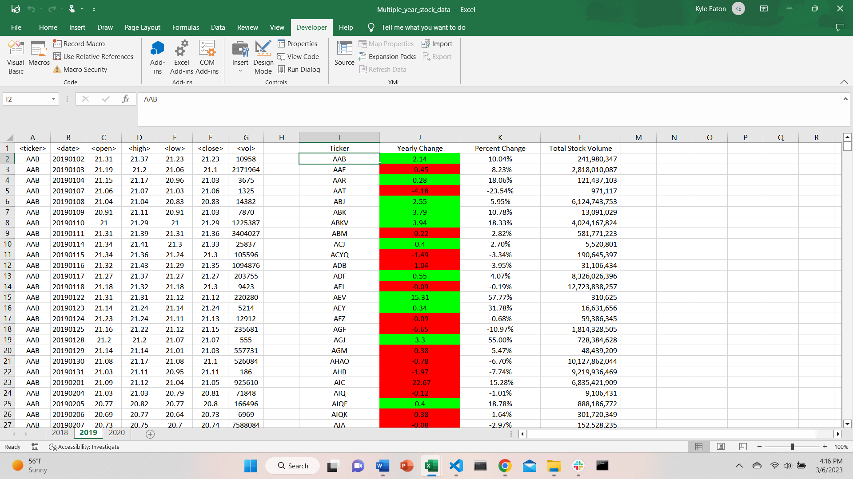

Slide 4
